Slide 1
CASE STUDY
BrightTV
Viewership Analytics & Subscription Growth Strategy
Insights to help the CVM team grow BrightTV's subscription base this financial year.
Prepared for
Period
The CEO & CVM Team
Jan – Apr 2016 | 20 min

Slide 2
AGENDA
What we'll cover today
01
The Brief
CEO objective & dataset overview
02
User & Usage Trends
Who is watching and when
03
Drivers of Consumption
Demographics, time, geography
04
Content Recommendations
Filling low-consumption days
05
Growth Initiatives
Building the subscriber base
06
Next Steps
Roadmap for the CVM team
BrightTV | Viewership Analytics — CVM Strategy
2 / 12

Slide 3
THE BRIEF
Grow the subscriber base — what the data tells us
"
5,375
Grow BrightTV's subscription base this financial year.
Unique users in dataset
10,989
Viewing transactions
— BrightTV CEO
Q1 2016
Jan – Apr observation window
Our role: surface insights from the viewership data that help the CVM team prioritise where to invest, what to programme, and which audiences to target.
9 prov.
National coverage (ZA)
BrightTV | Viewership Analytics — CVM Strategy
3 / 12

Slide 4
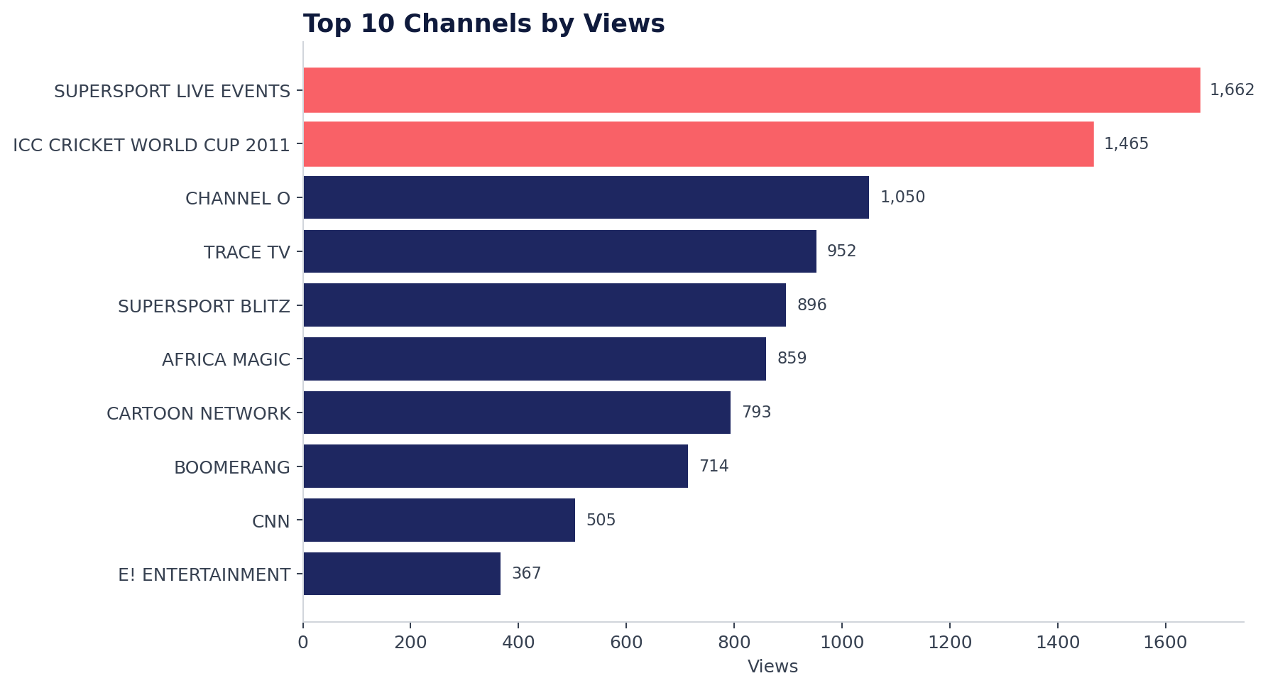
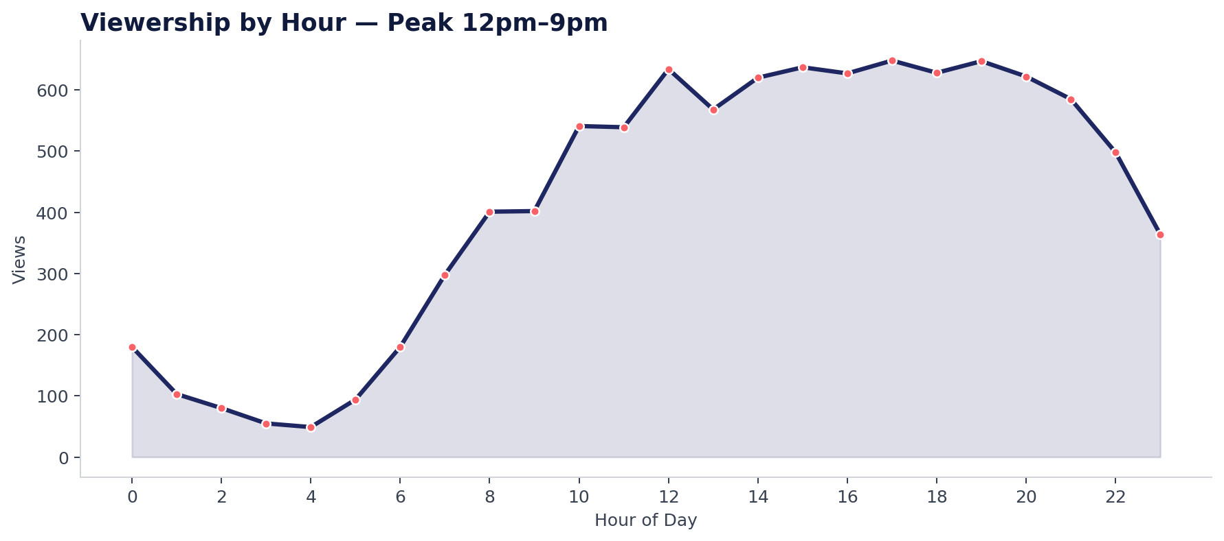
USER & USAGE TRENDS
A snapshot of who is watching BrightTV
73%
25-34
32%
12-21h
Male audience
Dominant age group
In Gauteng
Peak hours
Skews heavily male — only 10% female after cleaning
1,894 users (35% of base) — prime ad demographic
Single largest provincial concentration
~70% of all views fall between noon and 9pm
BrightTV | Viewership Analytics — CVM Strategy
4 / 12

Slide 5
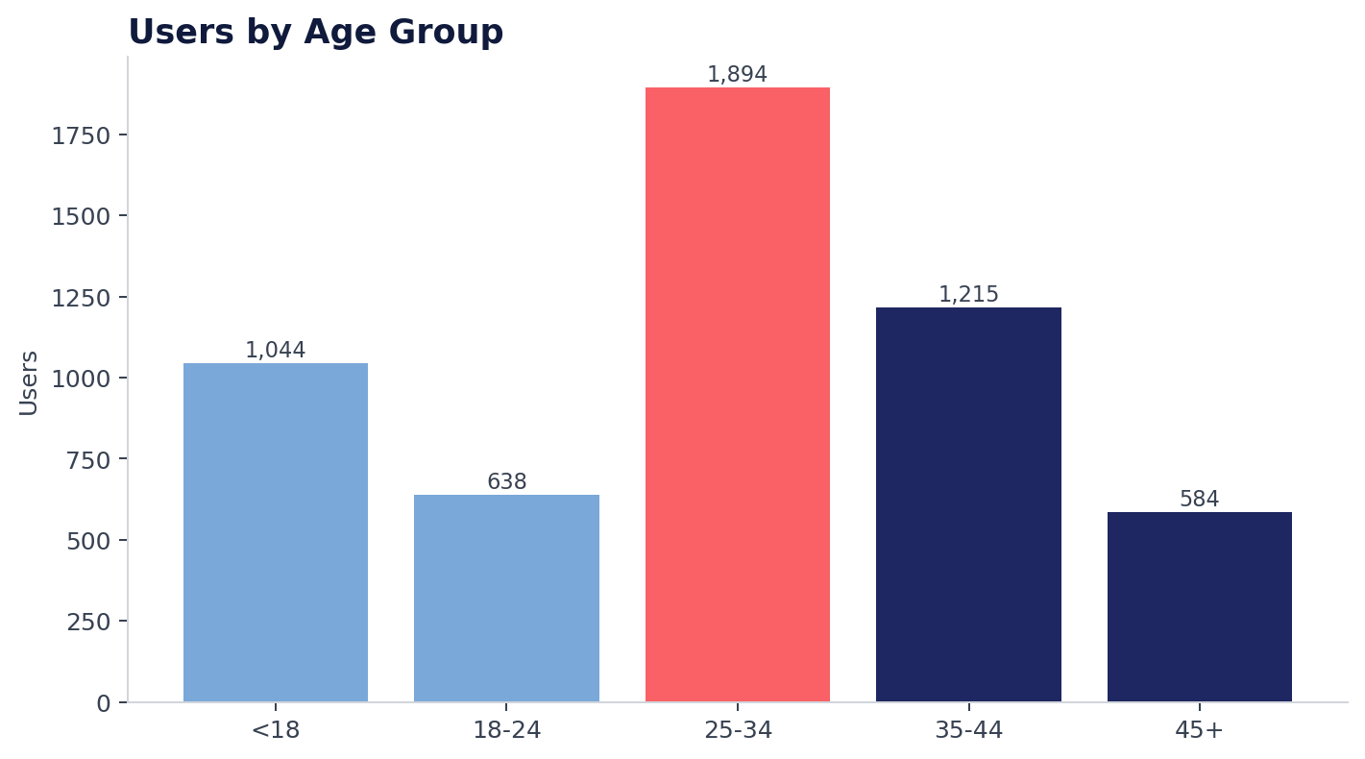
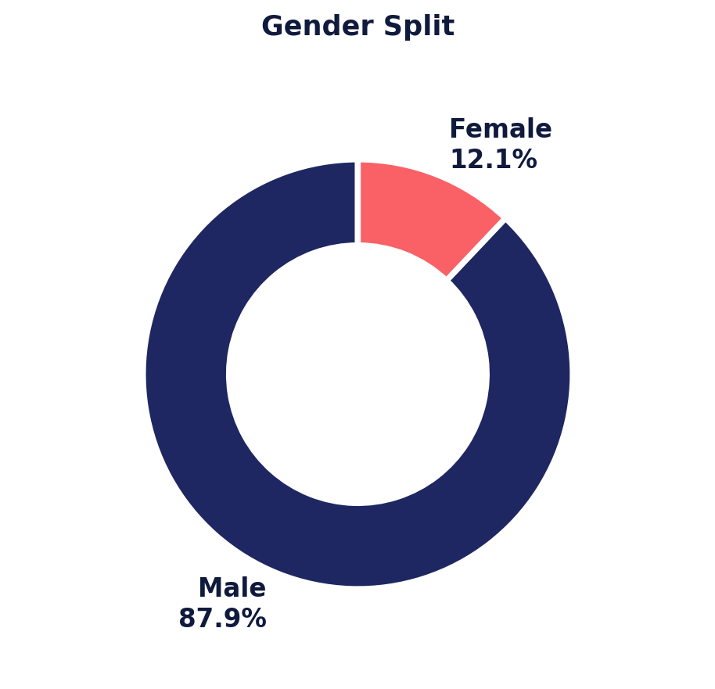
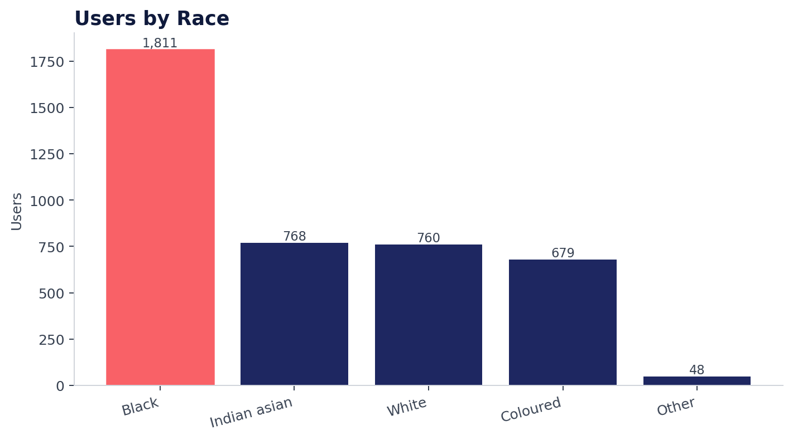
DRIVERS OF CONSUMPTION — PART 1
Who is consuming the most content?
Key Takeaways
25-34
Under 18
Male skew
Black & Indian
Largest segment — anchor monetisation strategy here.
Surprisingly large (1,044 users) — kids content is a real lever.
73% male — female acquisition is an untapped growth pool.
Two largest race segments — culturally relevant content matters.
BrightTV | Viewership Analytics — CVM Strategy
5 / 12

Slide 6
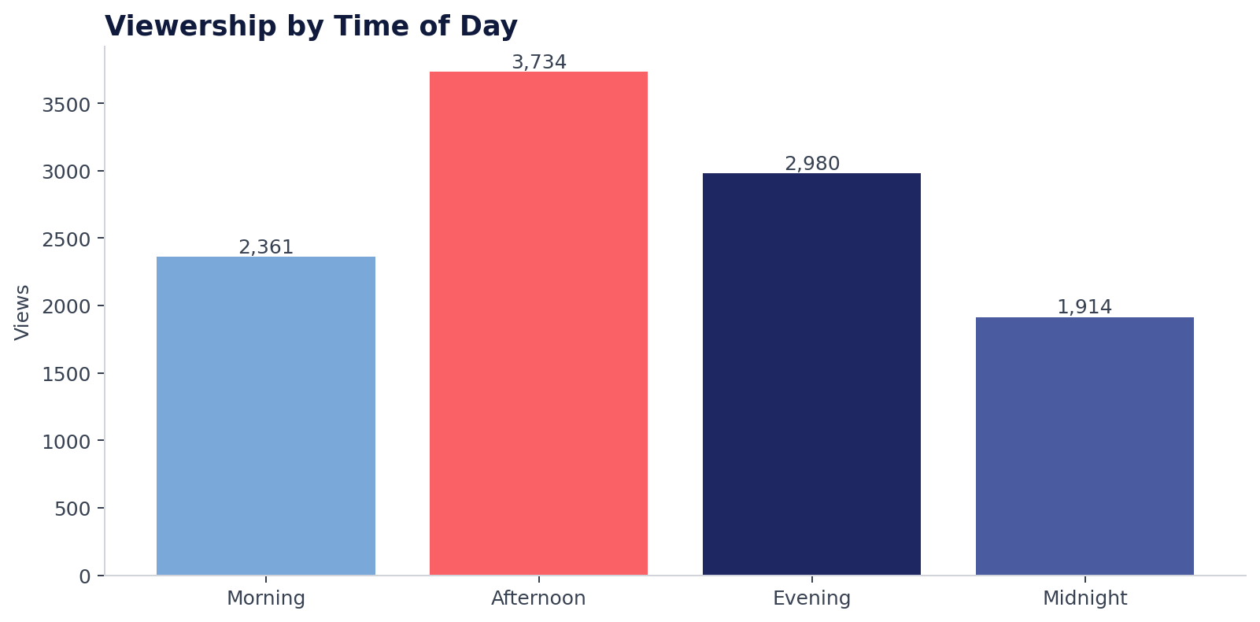
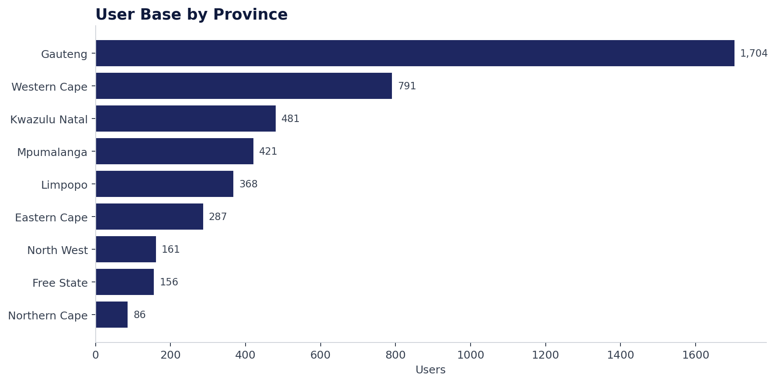
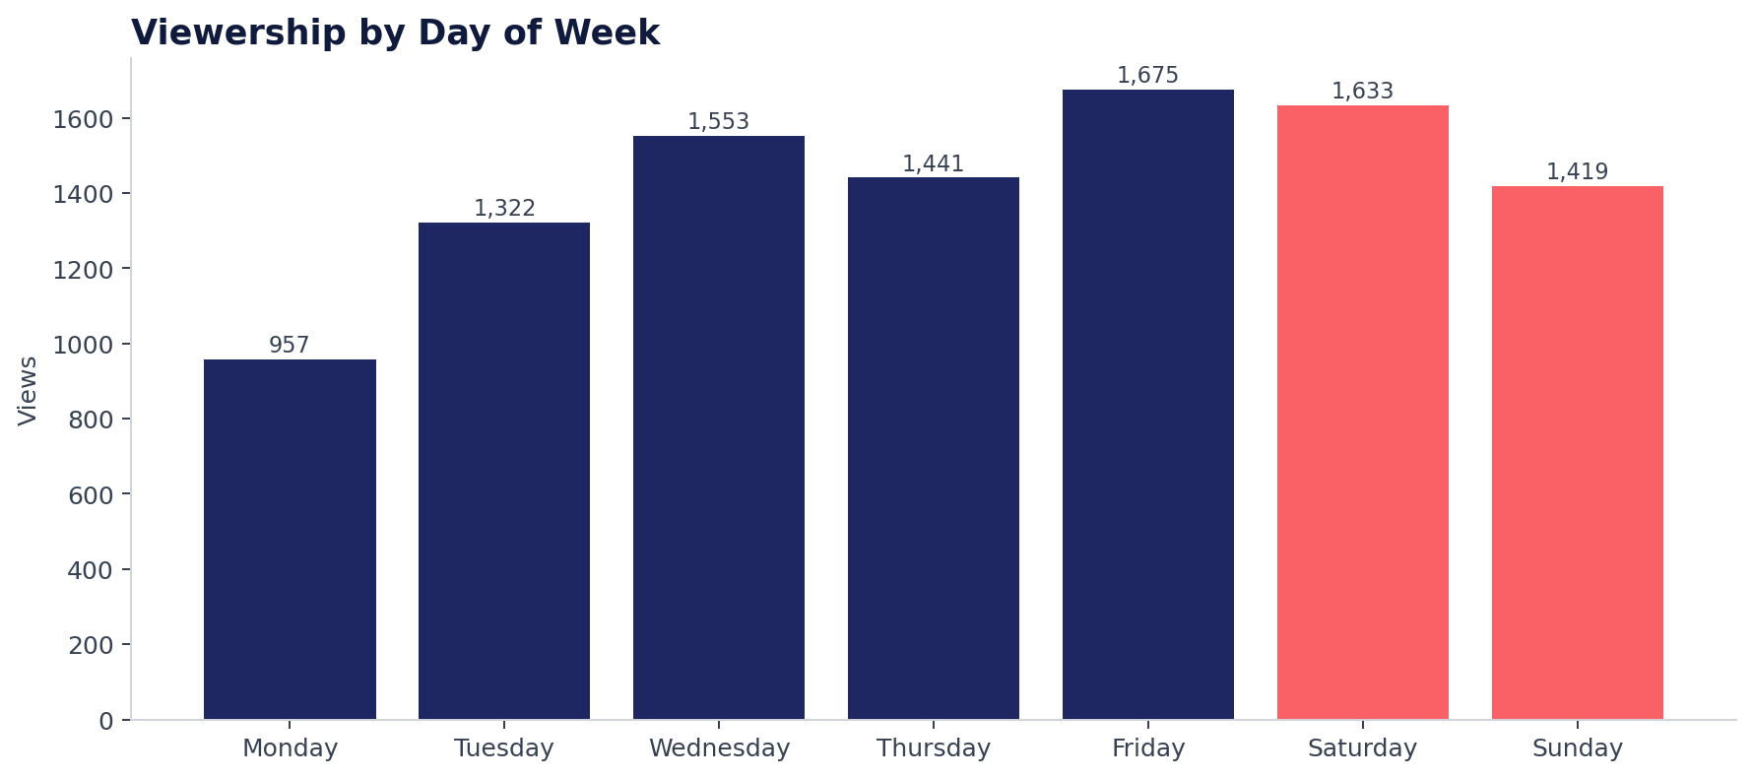
DRIVERS OF CONSUMPTION — PART 2
When and where consumption happens
Consumption is shaped by:
• Time of day — afternoon & evening dominate (61% of views).
• Day of week — Mon & Tue are the weakest days.
• Geography — Gauteng & Western Cape drive 46% of users.
• Genre — sport and music videos lead engagement.
BrightTV | Viewership Analytics — CVM Strategy
6 / 12

Slide 7
THE OPPORTUNITY
Mondays and Tuesdays under-perform
THE GAP
Monday is ~43% smaller than Friday
957 views on Mondays vs 1,675 on Fridays. Tuesdays sit just above at 1,322. The early week is where BrightTV is bleeding watch-time — and where new programming will move the needle fastest.
CONTENT TO LIFT MON–TUE CONSUMPTION
Live Sport
Reality & Drama
Kids Block
Music Top 40
Monday Night football & cricket re-runs — sport already #1 by views.
Premiere African Magic / M-Net originals on Mon–Tue evenings.
Cartoon Network & Boomerang marathons 15h–18h to capture <18 audience.
Trace TV / Channel O countdowns — high engagement, low cost.
BrightTV | Viewership Analytics — CVM Strategy
7 / 12

Slide 8
CONTENT RECOMMENDATIONS
A weekly schedule built from the data
MON
TUE
WED
THU
FRI
SAT
SUN
Morning
Morning
Morning
Morning
Morning
Morning
Morning
Kids: Boomerang
Kids: Cartoon Net
CNN World
CNN World
Lifestyle
Sport Highlights
Faith / Family
Afternoon
Afternoon
Afternoon
Afternoon
Afternoon
Afternoon
Afternoon
ICC Cricket
SuperSport Live
African Magic
African Magic
Movies
Live Sport
Live Sport
Evening
Evening
Evening
Evening
Evening
Evening
Evening
MNF Sport
Drama Premiere
Trace Top 40
Reality TV
Movie Night
Live Events
Sunday Movie
NEW
NEW
Late Night
Late Night
Late Night
Late Night
Late Night
Late Night
Late Night
Channel O
E! Late
Late Movies
Late Movies
Comedy
Live Concerts
Replays
New programming targeting Mon–Tue uplift
BrightTV | Viewership Analytics — CVM Strategy
8 / 12

Slide 9
WHAT INFLUENCES CONSUMPTION
Five forces shaping BrightTV viewership
T
TIME
Afternoon (34%) & Evening (27%) dominate. Midnight viewing still material at 17%.
D
DAY
Fri–Sat are peaks (30%); Mon–Tue troughs (-30% vs Fri).
A
AGE
25-34 = 35% of users. Under-18s a strong second segment.
G
GEO
Gauteng + Western Cape = 46% of base. Other 7 provinces under-served.
C
GENRE
Sport, kids and music videos drive >60% of all views.
BrightTV | Viewership Analytics — CVM Strategy
9 / 12

Slide 10
GROWTH INITIATIVES
Four bets to grow the BrightTV subscriber base
01 ACQUIRE
02 EXPAND
Female-First Campaign
Province Penetration
Women are 10% of the base. Run a female-led acquisition push (lifestyle, drama, telenovelas, beauty) backed by influencer partnerships. Target: +15% female sign-ups in 6 months.
Northern Cape, Free State and North West make up <10% of users combined. Bundle deals with regional ISPs and local-language content (isiXhosa, Sesotho, Afrikaans).
03 ENGAGE
04 RETAIN
Kids & Family Tier
Sport Super-Fan Bundle
1,044 under-18 users signal real demand. Launch a Family bundle (Cartoon Network, Boomerang, edutainment) priced for households — reduces churn by widening account use.
Sport (SuperSport, ICC) drives 28% of all views. Build a premium sport tier with exclusive live rights and second-screen stats — the highest willingness-to-pay segment.
BrightTV | Viewership Analytics — CVM Strategy
10 / 12

Slide 11
NEXT STEPS
90-day execution roadmap for the CVM team
DAYS 0–30
DAYS 31–60
DAYS 61–90
Discover
Pilot
Scale
• Validate insights with full-year data
• Launch Mon–Tue programming refresh
• Roll out province expansion
• Segment audiences in CRM
• Soft-launch female acquisition campaign
• Activate sport super-fan tier
• Brief content & marketing teams
• A/B test family bundle pricing
• Measure: subs, watch-hours, churn
TARGET KPIs
+12%
+25%
+15%
-8%
New subscribers
Mon–Tue watch hours
Female sign-ups
90-day churn
BrightTV | Viewership Analytics — CVM Strategy
11 / 12

Slide 12
THANK YOU
Let's grow BrightTV.
Questions, challenges and ideas welcome.
Prepared for the CVM Team • BrightTV • 2016

